Slide 2
Optical Market Revenues Rebound and More
According to The Vision Council’s Q3 2021 VisionWatch report, total eyewear sales for the 12 months ending September 2021 were $46.45 billion, a 24.0% increase from the same 2020 period and a 6.3% increase from the same 2019 period.
Although Q3 2021 was before the surge of the Omicron COVID-19 variant, the report indicates a complete recovery for the industry. For the third quarter alone, total sales increased 15.8% from Q3 2020 and increased 4.7% from Q3 2019.
Unsurprisingly, the pandemic drove many more consumers to purchase eyewear online. The VisionWatch report shows a 26.3% increase during the 12 months ending September 2021 to a total of $4 billion and frames and lenses accounted for almost half at $1.93 billion.

Slide 3
Consumer Purchase Insights
For the same 12 months in its Q3 2021 report, The Vision Council stated 126.9 million US adults had some type of managed vision care (insurance). More of those benefits were used during the period: 75.7% for adult eye exams and 60.9% for all purchases of frames.
Most of the frames consumers purchased were via the “independents” channel and it accounted for the largest share at 51.2%, followed by chains 26.5%, mass merchandisers/ clubs 10.9%, online/Internet 7.8%, other 3.3% and department stores 0.3%.
Each consumer-purchase channel for lenses was almost identical since most frames are purchased with lens: independents 51.7%, chains 26.7%, mass merchandisers/clubs 9.8%, online/Internet 7.3%, other 4.1% and department stores 0.3%.

Slide 4
Optometrists Practice Metrics Improve
The last Jobson Coronavirus survey of eyecare practices during December 2021 found a 12% YOY increase in profitability per patient, although the metric was still 1% less than the equivalent 2019 survey.
Overall practice revenue increased 15% YOY and 1% from 2019. The 14% YOY increase in patients per day and the 14% YOY increase in optical sales were likely primary factors.
Based on data from GPN, a software and data company for the optical industry, Eyecare Business reports total patient payments at practices increased 5.9% during December 2021 compared to December 2020 and 11.7% from December 2019.

Slide 5
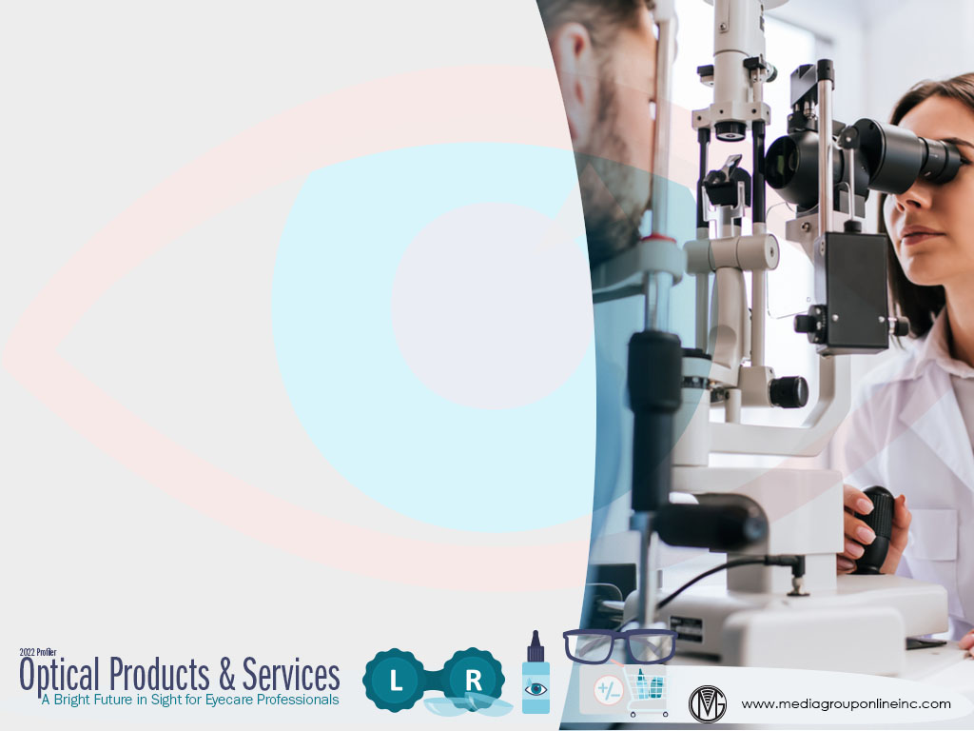
Many Optometrists Are Still in Recovery Mode
Although 98% of eyecare practices responding to the Jobson December 2021 survey said their practices were opened, 54% said they could serve more patients than they were currently. The biggest reason was a lack of staff at 54%.
Other barriers to serving more patients were lack of patient traffic 15%, government restrictions due to COVID-19 10% and others 36%. 66% of practices also said they were experiencing limited product inventory because of supply chain issues.
Almost half (46%) of survey respondents said product delivery delays were three to four weeks, which increased substantially from 37% during July 2021. Unfortunately, 58% thought patients would only be willing to wait two weeks for the frames they ordered.

Slide 6
Latest Eyecare Practices Insights
The survey of eyecare practices for Eyes on Eyecare’s annual Optometrist Report (2021) found primary eye care was the “current clinical focus” of 62.8% of respondents, with ocular disease second at 10.8% and cornea and contact lenses third at 7.6%.
The survey/report also revealed a major challenge for these eyecare practices: Patients taking their prescriptions to another optical business, which increased from 33.43% for 2020 to 36.97% for 2021, although the pandemic was likely a factor.
Unlike many other medical practices, only a third (33.3%) of these practices said they offered telemedicine, but the technology hasn’t advanced enough for eyecare professionals to conduct eye exams remotely.

Slide 7
Consumers’ Optical Products Purchase Plans
Analysis of five representative 2021 consumer/market surveys from The Media Audit shows an average of 24.1% of adults 18+ plan to buy glasses/contact lenses during the next 12 months, with women at an average of 59.0% and those 55-75 31.6% and 25-44 30.5%.
Glasses/contact lenses purchasers are primarily of middle to higher income: $35K–$75K at an average of 32.4%, $75K–$150K at an average of 31.3%, but 25.1% earn $35K or less.
Data for heavy exposure to 10 different media revealed consumers planning to buy glasses/contact lenses during the next 12 months over-indexed for television in all five markets, as well as the Internet, podcast listening and video streaming.

Slide 8
Advertising Strategies
Eyecare consumers are a very broad audience and over-index for heavy exposure to TV, which makes this ad medium superior for building retail brand awareness and when combined with special offers via direct mail maximizes exposure for optometrists.
Use the second table on page four of the Profiler to help optometrists understand how targeted TV campaigns will maximize their revenues for these clinical specialties that are expected to offer the largest opportunities for eyecare professionals.
Although the data shows the optical products & services sector has largely rebounded from pandemic lows, many consumers have delayed exams and the purchase of new eyewear. Optometrists who increase their ad spending can gain a greater share of these revenues.

Slide 9
New Media Strategies
More consumers choose where they spend their money based on a business’s transparency. Optometrists can use social media to post regular updates about continued delivery delays of patients’ frame and other product purchases.
With more people working at home and at their computer more hours, more are experiencing dry eyes. Create and post a poll/survey asking consumers how they’ve addressed their dry eye issues and provide clinically proven remedies.
Use social media to engage with the 25% of consumers with incomes of less than $35K and who are planning to buy glasses/contact lenses. Posts can feature low-cost, good quality products and possible exam discounts to attract more of this consumer segment.

