Slide 1
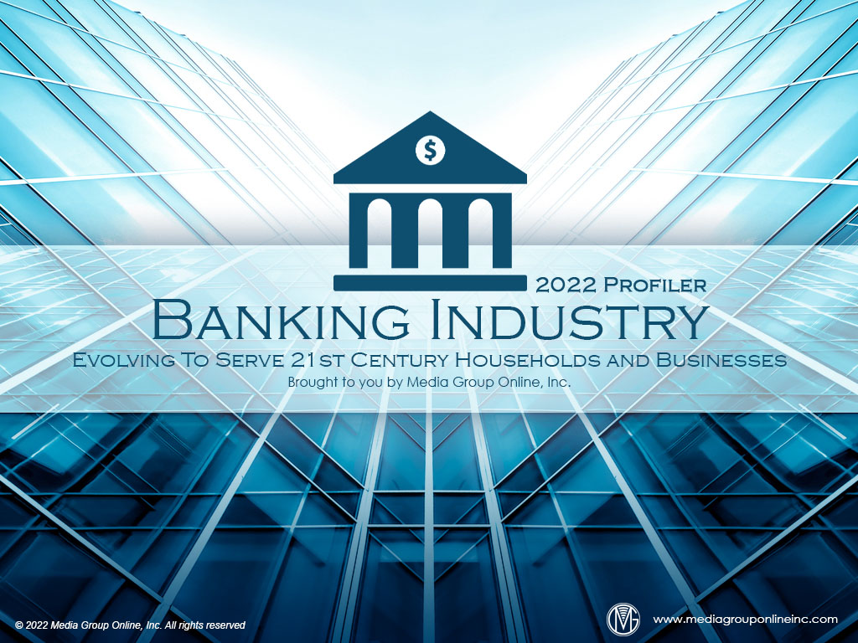

Slide 2
Banks’ Assets and Profitability Increase
Despite the continued uncertainty about the pandemic and the conflict in Ukraine, two (Bank of America and Citigroup) of the top four banks by assets reported a profitable Q1 2022 while the other two (JPMorgan and Wells Fargo) missed their revenue/profit estimates.
According to the Federal Deposit Insurance Corporation (FDIC), total Q4 2021 assets at all insured institutions were $23.72 trillion, an 8.5% YOY increase. Commercial banks’ assets increased by 8.3% YOY and saving institutions’ assets increased by 10.1% YOY.
Although banks have had fewer branches for more than a decade, the pandemic accelerated branch closings. S&P Global Market Intelligence reported a net closure of 2,927 branches during 2021, a 38% YOY increase. Wells Fargo had the most closures at 267.

Slide 3
Households’ Financial Condition
Banks and the entire US financial industry depend on a growing, stable economy and household finances. Despite low unemployment, many economic pressures caused Morning Consult’s Index of Consumer Sentiment to decrease by 0.9 points during April 2022.
Surveyed consumers’ expectations for personal finances 12 months from April increased by 2.4 points, the only component of the Index that did. Current buying conditions decreased the most by 3.0 points while 12-month business conditions decreased by 1.4 points.
Although there are millions of job openings and many employers are offering higher pay, 13.6% of households earning less than $50,000, which are often the biggest drivers of the economy, experienced income loss during April, compared to 13.1% from the March survey.

Slide 4
Inflation Is the Top Concern
A Gallup poll conducted during the first half of April 2022 found inflation was the most-critical concern of respondents. Gallup’s Economic Confidence Index was -39, but still much better than the -72 during the 2008 recession.
The survey for Morning Consult’s May 2022 US Economic Outlook found expenses exceeded income for 73% of households earning less than $50,000 during March 2022 while just 20% of households earning $50,000–$99,999 didn’t have adequate income to cover expenses.
Among all US adults, 16.8% said their household expenses exceeded their income during March 2022, the second-most since March 2021. January 2022 recorded the largest percentage at 18.6% during the surge of the Omicron variant of the COVID-19 virus.

Slide 5
A Focus on African Americans’ Finances
An October 2021 Pew Research Center survey revealed 59% of African Americans said they had the income for their basic needs with a significant amount remaining for extras at 14% and a little remaining for extras at 45%.
Much has changed in the US economy and personal finances since October 2021. A more recent (January 2022) Pew survey found 69% of African Americans said strengthening the economy was a top priority, but dealing with the coronavirus outbreak was first at 74%.
Of the African Americans participating in a ThinkNow December 2021 survey, 42% of them said their 2021 household incomes had improved by 18% from 2020, which isn’t surprising; however, 49% said their 2022 finances would be better than 2021, decreasing by 4%.

Slide 6
African Americans’ Banking Experiences
According to results from a February 2022 Morning Consult survey, banks must do a better job serving African Americans as the survey found 55% of them said the nearest branch of their bank was 10 minutes or more distance, the most of all ethnic groups in the survey.
Interestingly, more African Americans used a digital wallet every day (11%) or several times a week (25%) than Caucasian Americans (20% total), Latinx Americans (33% total) and all other ethnicities (26% total).
African Americans’ use of a digital wallet is also reflected in the 52% who said they applied for a personal loan online versus 40% of Caucasian Americans. 37% of African Americans had opened a bank account online versus 24% of Caucasian Americans.

Slide 7
Banks’ Opportunities with Young Adults
Young adults have many unique financial challenges. Many Gen Zers must secure student loans, buy a vehicle and address rent increases while Millennials are buying homes, starting families, balancing their household budgets and saving for retirement.
Research indicates almost half (46%) of Gen Zers seek information about personal finances on social media platforms and from influencers. Banks can engage with Gen Zers by partnering with influencers to provide Gen Zers with in-depth educational content.
Millennials’ financial goals are somewhat different. A December 2021 Morning Consult survey found “establishing an emergency fund” and “creating and maintaining a budget” were their primary goals, both at 89%.

Slide 8
Americans Are Generally Satisfied with Banks
The Morning Consult’s monthly banking/personal finances surveys reveal slightly more than half of adults say they have a relationship with a traditional bank within a range of 52% to 54% for the July 2021–March 2022 period.
Morning Consult’s March 2022 survey results also found only approximately 15% of adults plan to start a new relationship with a financial services provider during the next six months. Many are reluctant to change banks during the current economic conditions.
As online banking has increased in popularity, a 2022 survey from Quantum Metrics found 83% of adults said easy access to their accounts online was the #1 factor when deciding to use a particular bank or financial institution.

Slide 9
Digital Wallet Trends
As consumers avoided touching payment devices in stores during the pandemic, the use of digital wallets increased. According to Morning Consult, approximately 65% of adults used a digital wallet during July 2021 and slightly more during January 2022.
As thousands of bank branches have closed, it’s unsurprisingly that 52% of adults told Morning Consult they didn’t visit a branch during March 2022 and another 38% only one to three times. Similarly, 41% didn’t visit an ATM and 43% just one to three times.
By comparison, 39% of adults said they didn’t use a digital wallet during March while 15% said several times per week, 13% approximately once per week, 15% every other week, 13% once and 5% every day.

Slide 10
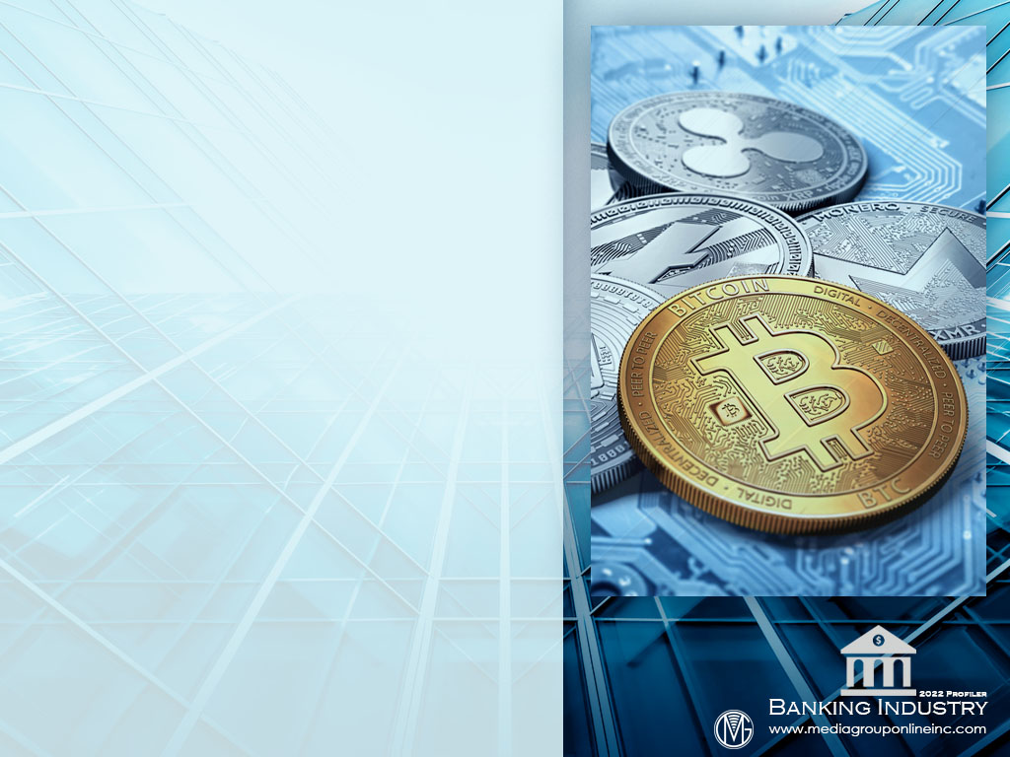
No Stopping the Fintech Industry
The continuing growth of the global fintech industry is challenging many traditional banks to convert their long-term infrastructure to cloud-based systems. Total 2021 VC global investments were $115 billion, compared to $53.2 billion during 2018, the previous record.
Despite personal and governmental concerns about cryptocurrency, 2021 global investments in the crypto and blockchain sector increased almost six times, from $5.4 billion during 2020 to more than $30 billion.
According to KPMG’s Pulse of Fintech Report for the second half of 2021, VC investments in the Americas reached $105 billion at the end of June 2021, compared to $25 billion at the end of June 2020.

Slide 11
Consumers’ Fintech Experiences
The Plaid/The Harris Poll July 2021 survey revealed a 52% YOY increase of US consumers using fintech, from 58% (2020) to 88% (2021). Driving that increase is the 80% of Americans who want to connect their bank account to the digital finance apps they use.
The increased use of fintech has resulted in a majority (63%) of Americans feeling comfortable about discussing financial topics with friends and 57% have adopted a fintech app based on a recommendation from a family member or friend.
Unsurprisingly, Gen Zers at 49% and Millennials at 55% use fintech tools or apps every day while that use has increased 30% for all Americans, from 37% (2020) to 48% (2021).

Slide 12
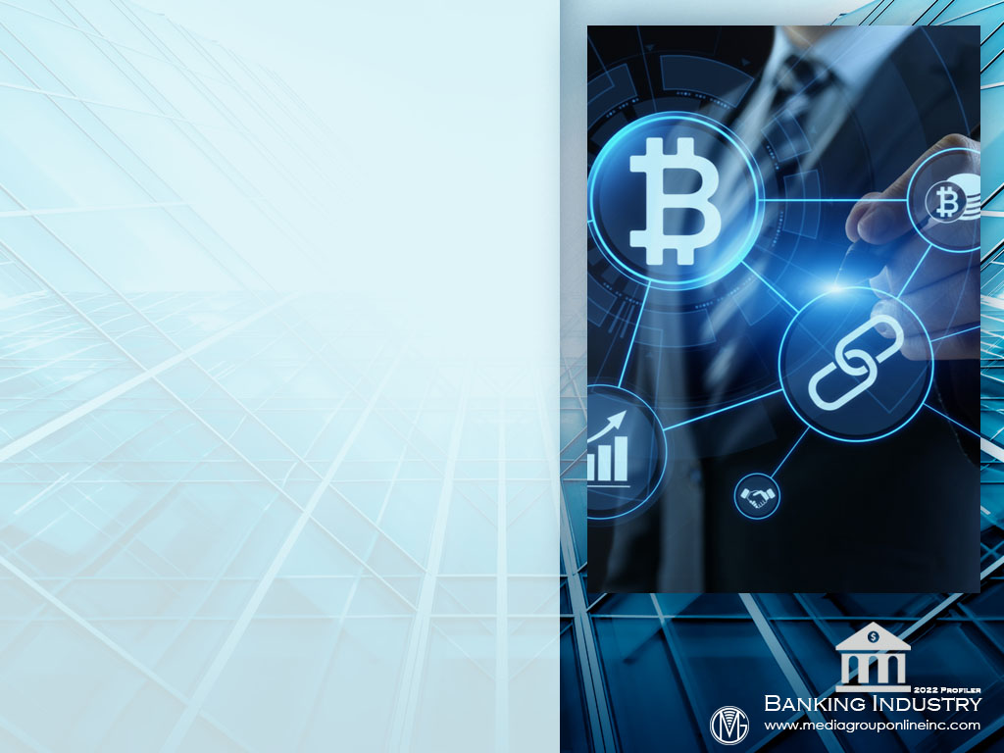
Cryptocurrency Is Still a Mystery to Many Americans
Although investments in cryptocurrency have increased substantially, the March 2022 Morning Consult survey found more US adults (36%) who were aware of cryptocurrency didn’t trust it, primarily because of fewer government regulations.
Nonetheless, 24% of US adults said they plan to buy cryptocurrency during the next month, which was the same for buying Bitcoin. Fewer were expected to buy Ethereum (16%) and Dogecoin (13%).
The mystery of cryptocurrency is clearly revealed in the 57% of US adults who told Morning Consult in the March 2022 survey that they didn’t understand it as well as the 54% who said they didn’t trust it and 49% who said they didn’t think it was secure.

Slide 13
Banking Trends
Banks must be prepared for the Federal Reserve’s introduction of FedNow during 2023, a real-time payment system that will allow the transfer of money within seconds. Other countries, including China, Brazil and India have already launched these systems.
Neo-banks, or those that only operate online, are attracting more small businesses. BAI, a nonprofit financial services company, found 24% of businesses with less than $1 million in annual revenues are using neo-banks primarily because of their personalized services.
To serve their customers better, especially young adults, banks are also challenged to advance their use of various technologies, especially artificial intelligence (AI). More sophisticated AI applications can create more efficiencies and protect against fraud.

Slide 14
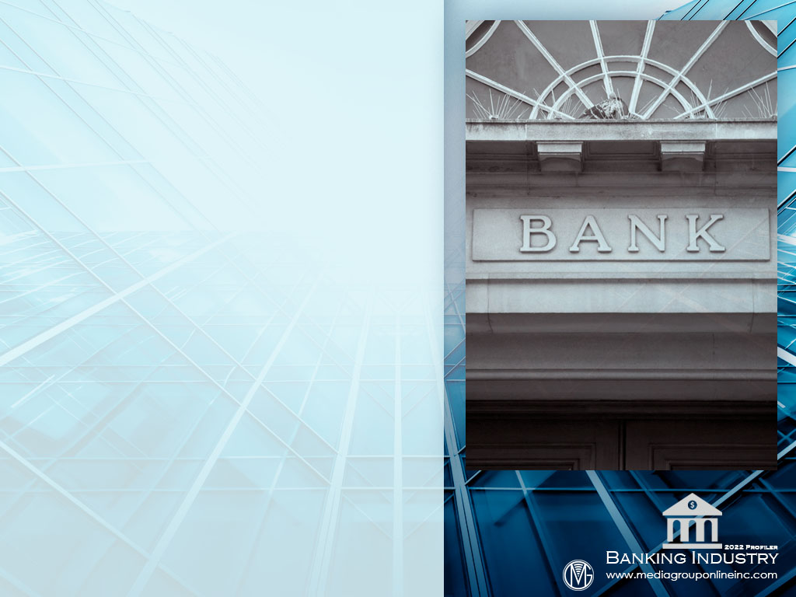
Advertising Strategies
The primary reach media of TV and radio are important channels for banks to reinforce their brands, but also to engage with young adults and direct them to social media pages and Americans not using banks who would benefit from banks’ convenience and security.
Banks can use legacy media to brand themselves as excellent sources of information and advice about personal finances, especially during the current economic conditions. Offer the incentive of a gasoline card for an in-branch consultation.
Banks should allocate part of their ad budgets and messages to show how they are improving their technologies, such as artificial intelligence and mobile banking, to help make their financial management more efficient.

Slide 15
New Media Strategies
Banks can use social media to share the positive aspects of the current economy to help consumers feel more confident and secure. Short videos presented by hosts to represent different age groups are more effective than bank officials.
To improve their engagement with young adults, especially Gen Zers, banks should seek and create partnerships with credible financial influencers of the appropriate age and ask them to provide short videos and other content for banks’ Websites and social media pages.
Banks can also use social media to post a series of short videos and other content about important financial topics, such as how to create and balance a household budget, the intricacies of securing a student loan, how to be a smart consumer, etc.

