Slide 1
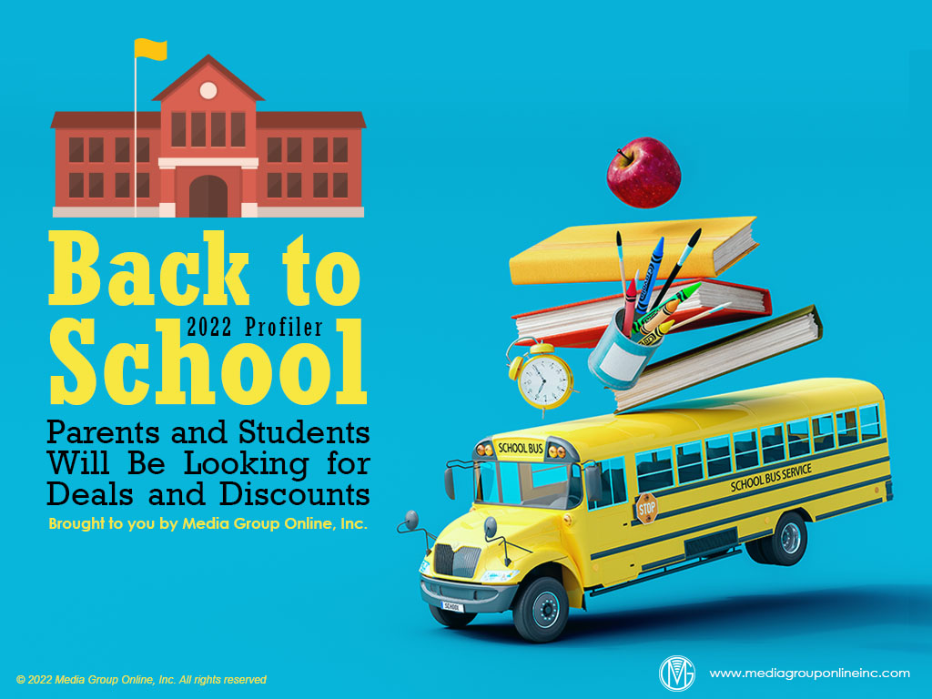

Slide 2
Consumer Spending Is the Make-or-Break Factor
Brands and retailers will have a good 2022 Back to School season if consumers continue to spend as they did during April 2022, when retail sales increased 0.9%, which they also did during the three previous months.
More inflation; continuing supply-chain issues, resulting in less inventory in stores and online; and the possibility of a recession, which could negatively affect employment, could reverse increasing retail sales during the critical June–September shopping season.
Generally, households with incomes of less than $50,000 drive the economy, including Back to School; however, 13.6% of these households experienced income loss during April 2022.

Slide 3
Inflation May Affect Back-to-School Spending
According to multiple sources, inflation is now most Americans’ top concern, replacing the pandemic. Other sources also emphasize the current inflationary trend is different than those of the past and may start to moderate as early as late 2022.
In its May 2022 U.S. Supply Chains and Inflation report, Morning Consult found many consumers are delaying certain types of purchases, especially non-essentials, or choosing less-expensive products. This trend is likely to continue into the Back-to-School season.
Morning Consult found inflationary pressures, such as price sensitivity and purchasing difficulty, were starting to affect higher-income households as these pressures have already affected those with middle to lower household incomes.

Slide 4
Back-to-School Shoppers
According to Quantum Metric’s Making the Grade report, 71% of parents are making back-to-school purchases for their school-age children, compared to 27% for their college-bound children, but 61% of those students purchase for themselves.
Interestingly, 48% of purchases for supplies for school-age children and 29% for college-bound students are “gifts.”
The 2022 report also found many parents planned Back-to-School purchases for fall 2022 before the 2021–2022 school year ended and primarily because of inventory concerns. These earlier purchases are more likely for college than school-age students.

Slide 5
College Student Insights
Although August is the traditional month when college students start their back-to-school shopping, more than half start before August and 45% are shopping online more than before the pandemic, according to Student Bean’s Back to School 2022 report.
The report also revealed 84% of college students are more likely to click on an ad with a large discount and 94% will buy the product with a student incentive compared to those without such an incentive.
The health & wellness trend is very important to college students, as the report found 89% of those 16–24 want to be more physically fit during the coming school year and 85% are focused on improving their health.

Slide 6
Tweens and Teens and Media
Piper Sandler’s Spring 2022 Taking with Teens survey revealed TikTok is now teens’ favorite social media platform at 33%, with Snapchat a close second at 31%. Snapchat’s 22% was the same as the fall 2021 survey while Facebook was the favorite of just 3% of teens.
The Common Sense Census 2021 report of media use by tweens and teens stated 53% of 13- to 18-year-olds said Instagram was their top social media site and Snapchat second at 49%. Among those 8 to 12, Snapchat was first at 13% and Instagram second at 10%.
Compared to Common Sense’s 2019 survey, fewer tweens (8–12) were gaming than were gaming in the 2021 survey, or 64% and 59%, respectively, however, teens (13–18) were gaming more, or 56% and 59%, respectively.

Slide 7
Following Gen Zers into the Metaverse
Although the metaverse concept is still a mystery to many, Gen Zers are very positive about the metaverse. In fact, Razorfish’s April 2022 study, The Metaverse, found 52% of Gen Zers said they feel most able to be completely themselves in a game.
More than Millennials, Gen Zers said the benefits for them in gaming were self-exploration at 45%, self-confidence at 40% and “a more authentic expression of myself” at 34%. This was even more among BIPOC (black, indigenous, people of color) Gen Zers at 50%.
The surveyed Gen Zers also said gaming has a positive effect on their relationships: 65% said they’ve developed new relationships and 64% strengthen existing relationships.

Slide 8
Advertising Strategies
With inflation causing families to shop for bargains and value brands, co-op advertising dollars could be the difference for many Back-to-School retailers. Visit the Localogy Co-op Connect database on the Media Group Online Website for all the details.
The Common Sense survey results on page 3 of the Profiler show a majority of tweens and teens are watching TV on a TV set, making it an excellent reach medium for retailers. Tweens and teens heavily influence their parents’ Back-to-School spending.
Research continues to indicate Millennials, who are the parents of many school-age children, choose to engage with direct mail as a respite from too much screen viewing. Back-to-School retailers can use direct mail in a media mix with TV, radio or social media.

Slide 9
New Media Strategies
Amidst continuing supply-chain and inventory issues, retailers can use social media posts to provide customers with regular updates about the status of inventory, especially critical Back-to-School items, from apparel to electronics to dorm room furniture.
Because 61% of college students purchase Back-to-School items themselves and many are shopping earlier, retailers in this vertical can gain a competitive edge with early specials promoted on college students’ favorite social media platforms.
The research shows college students are more likely to buy a product with a student incentive, suggesting this is a critical element of all Back-to-School retailers’ social media posts. Similar incentives for school-age children are likely to attract them and their parents.

