Slide 1
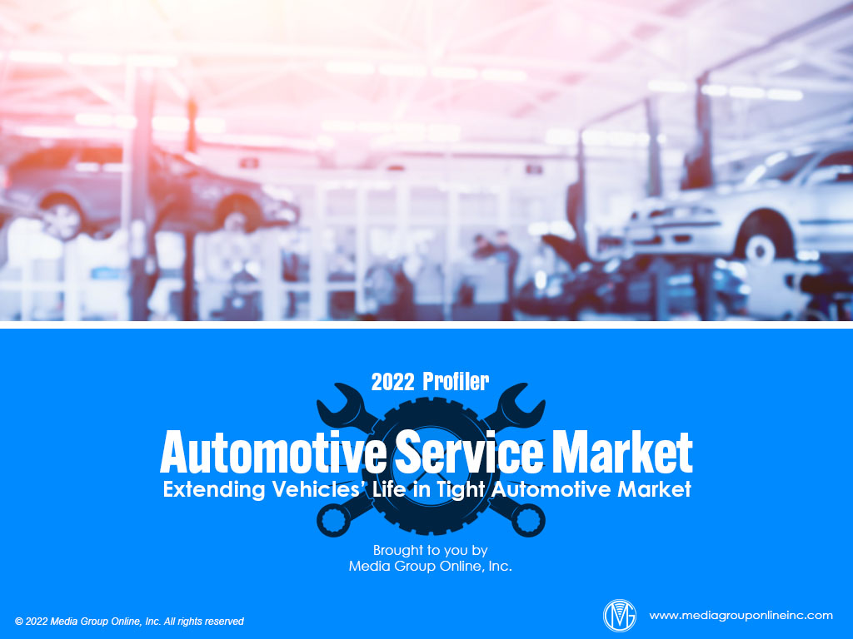

Slide 2
Record Vehicle Prices Driving Service Work
With new and used vehicles in very limited supply and at record-setting prices, it’s unsurprising the average age of vehicles on American roads continues to increase and causes owners to schedule service work to keep those vehicles operating.
According to 2022 data from S&P Global Mobility, the average age for all light vehicles was 12.2 years and almost two months older than 2021. Passenger cars had the oldest average age at 13.1 years and light trucks at 11.6 years.
Data from franchised dealerships using Cox Automotive’s Xtime service software, revealed its May 2022 Repair Order Volume Index decreased 1.6% YOY to 86.9; however, the Repair Order Revenue Index increased to 126.8, indicating more revenue from fewer orders.

Slide 3
On the Road Again
As more Americans have returned to their “normal” activities, they are driving more. According to a March 2022 survey from Morning Consult, 31% of vehicle owners had taken a road trip of 300 or more miles during the past month.
Interestingly, Gen Xers and Baby Boomers were the generations taking the most road trips of 300 or more miles at 39% and 43%, respectively, compared to 25% of Gen Zers and 25% of Millennials.
Millennials may not have taken more road trips of 300 miles or more, but 13% took three or more road trips during the past month, compared to 6% of Gen Zers, 4% of Gen Xers and 3% of Baby Boomers.

Slide 4
Adaptable Independent Repair Shops Succeed
Independent repair shops have had to face new challenges each year from the start of the pandemic. First, during 2020, they had to keep their staff and customers safe and then labor shortages and during 2022, supply-chain issues caused parts shortages.
According to a February 2022 survey of 500 independent repair shops from IMR, 35.8% were experiencing parts shortages, 31.8% attracting previous customers and providing incentives, 29.4% finding affordable parts and 27.0% receiving parts on time.
It was generally the larger shops (4–7 bays and 8+ bays) that had the most problems with parts shortages at 41.9% and 50.0%, respectively, compared to just 8.8% of shops with 1–3 bays. Their biggest challenge was finding qualified technicians at 29.4%.

Slide 5
Understanding the Service Customer
The Morning Consult survey cited on slide #3 showed 43% of adult vehicle owners said they chose to have their vehicle serviced at a dealership because of its “certified mechanics and technicians.” A close second was “familiarity/comfort with the dealership” at 42%.
Cox Automotive’s 2021 Service Industry Study generated similar results: “They know my vehicle” at 55%, “prior experience” at 46%, “location” at 41% and “they know me” at 33%.
In the Morning Consult survey, “price” at 67% was the overwhelming reason adults didn’t have their vehicle serviced at a dealership. “Trusted others more” was second at 27%, followed by “location” at 24% and “turnaround time” at 16%.

Slide 6
In Search of Service
According to Digital Air Strike’s 2021 Automotive Customer Experience Trends Study, two-thirds (67%) of respondents said they only used online searches to choose a dealership for service on their vehicles, compared to 46% in the 2020 survey.
Unsurprisingly, Google is where these vehicle-service customers searched the most at 60%, followed by Kelley Blue Book, Cars.com and CarGurus at 17% each, Autotrader at 13%, Facebook and Edmunds at 6% each and Yelp at 4%.
Dealerships aren’t doing a very good job at taking advantage of online reviews. A majority (71%) of survey respondents said the dealership where their vehicle was serviced did not ask them to write a review, but 58% said review sites were helpful.

Slide 7
Challenges for Body Shops
Dealerships with body shops would like them to generate more revenue, but according to the NADA, total 2021 body shop sales at franchised dealerships decreased 4.3% from 2020 and fewer dealerships had body shops at 35.7%, compared to 37.3% during 2020.
Truck dealerships’ body shops performed better as a revenue stream. The average body shop sale was $329.39 during 2021, a negligible decrease from $329.63 for 2020.
An April/May 2022 DealerRater survey reveals the reason dealerships aren’t generating as much revenue from their body shops. The survey found most customers (16%) chose a body shop based on their insurance company’s recommendation.

Slide 8
Advertising Strategies
Dealerships’ service departments and independent shops have a window of opportunity to target current vehicle owners with ad messages about the importance of maintaining their current vehicle during the lack of new and used vehicles and high prices.
Outdoor media will likely prove beneficial to automotive service departments. Feature a “certified” mechanic on each billboard or other outdoor display with a short headline about how much care they take when servicing a vehicle. Include his or her name.
Automotive service departments with a valet or mobile service can use direct mail to reach Millennials and older adults to promote the convenience of the service. Include a coupon or QR code for an introductory offer for first-time customers.

Slide 9
New Media Strategies
Automotive service shops can use their social media platforms to promote regional attractions to visit by vehicle and a checklist of vehicle maintenance items for families before they take a trip. Provide a discount to those who post online reviews.
Consumers want to do business with local service shops that honestly share information about how parts shortages, labor issues and other challenges may cause repairs to take more time.
With most consumers searching online for an automotive service business and most of them on Google, local shops should review their Google business listings to update any information and highlight the most positive reviews.

