Slide 1
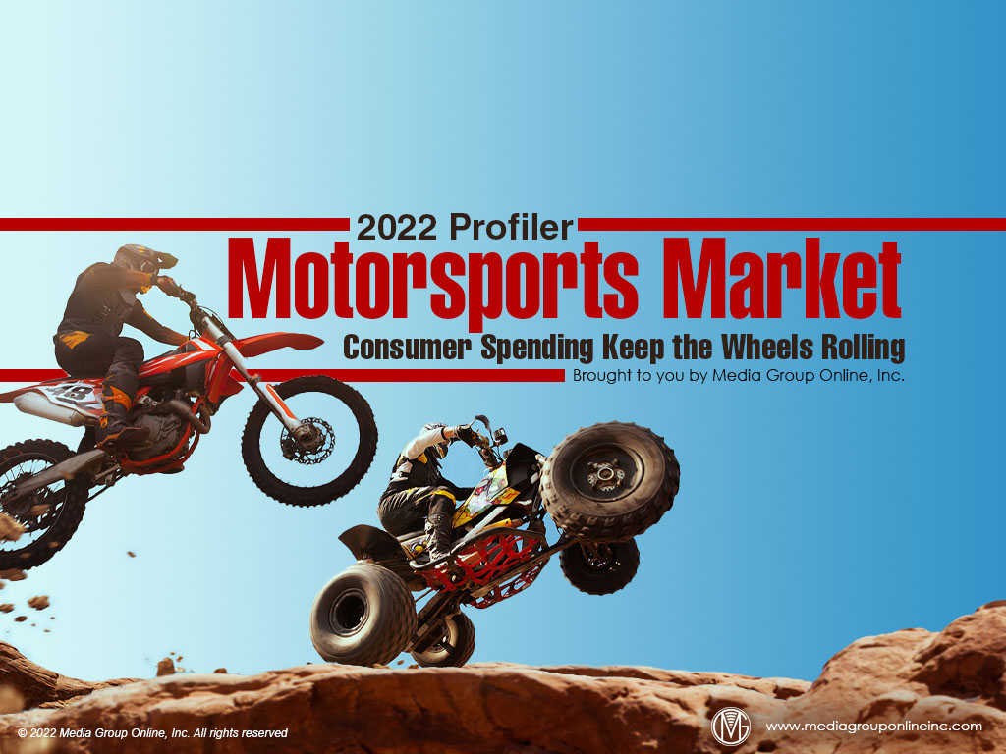

Slide 2
Business Conditions Remain Strong, Despite Inventory Issues
In the latest (Q4 2021) Powersports Business/BMO Capital Markets Dealer Survey of dealers in 36 states and four Canadian provinces, 77% of responding dealers were positive about business conditions: “very strong” 25% and “good” 52%.
Nonetheless, like the automotive industry, motorsports manufacturers and dealers face similar supply-chain issues for units and parts, labor shortages and inflationary price pressures. Some dealers indicated demand was still strong, but often exceeding supply.
Supply-chain issues are unlikely to improve before summer 2022, which may be the primary factor why 31% of dealers responding to the Q4 survey said their business was less than expected compared to 20% who said their business was more than expected.

Slide 3
Dealers’ Regional Business Performances
Supply-chain issues have also negatively affected dealers’ sales by region (see table on page 1 of the Profiler), according to CDK Lightspeed DMS data from more than 1,650 US dealerships.
From July through November, service departments recorded the best revenue performances because, like the automotive sector, powersports owners were having their existing units serviced since dealers’ inventories were so low.
Somewhat surprisingly, Northeast, Midwest and Northwest dealers had better overall sales performance than the South and West, which are often the strongest regions.

Slide 4
Motorcycle Sector Keeps Humming
According to Motorcycle Data, total US motorcycle sales decreased 19.2% during Q3 2021 after a 19.4% increase during the first half of the year. Total sales for the first nine months of 2021 were flat but increased 24.1% compared to the first nine months of 2019.
The Q3 2021 decrease in sales was because of inventory shortages, not less consumer demand, and the industry has reached a peak not experienced for a decade. Despite inflationary pressure on prices, the motorcycle market is expected to grow during 2022.
Harley-Davidson reported a 12% increase in wholesale shipments of motorcycles during Q3 2021 and, according to the November 2021 issue of Powersports Business, Harley-Davidson expected a 30% to 35% increase in total 2021 motorcycle segment revenues.

Slide 5
New Snowmobile Sector Insights
According to Powersports Business, 84% of the snowmobiles purchased during the October 2020–September 2021 period were new units and 16% were used.
Midwest dealers sold 47% of all units, the top region, with the Northeast dealers second at 21%, West dealers third at 19%, Northwest fourth at 12% and South last at 0%.
Northwest region dealers, however, sold the largest average number of units of those types measured in the study at 89%, with the Midwest second at 77%, followed by Northeast 73%, West 60%, South 48%.

Slide 6
Gen Xers Power Personal Watercraft Sector
In its December 2021 issue, Powersports Business reported Gen Xers were the primary purchasers of personal watercraft (PWC) during the October 2020–September 2021 period, according to the table on page 3 of the Profiler.
During that period, 91% of all PWC units sold were new and 9% used. Unsurprisingly, dealers in the South region had the largest average PWC units sold during the same period at 97 and the largest percentage of total PWC unit sales at 49%.
Powersports Business reported in its January 2022 issue that 61% of the 68,000 new PWC units sold during the same period were purchased with attached accessories. Half of those aftermarket accessories were body parts.

Slide 7
Major Manufacturers’ Financials
Polaris North America Q3 2021 gross profits decreased 13% YOY, with supply-chain and inventory issues the primary factors. The boat segment increased 18% YOY and motorcycles increased 16% YOY, but off-road vehicles and snowmobiles decreased 6%.
BRP North America experienced similar supply-chain and inventory challenges, resulting in a 20% YOY decrease in powersports retail sales for the three months ending October 2021. Boat retail sales decreased by 27% YOY.
Ducati experienced significant growth during 2021, with a 24% YOY increase for total units sold and a 12% increase compared to 2019. Motorcycle sales in the US increased by 33.5%, which became the top market, exceeding sales in Italy.

Slide 8
Advertising Strategies
Like the automotive market, the motorsports market may find it beneficial to turn to a pre-order business model, so sales and interest rates can be booked in advance. Promote pre-ordering with a discount for the first 50 orders or during a specified period.
With limited inventory and slow shipments, motorsports dealers can promote their service departments aggressively to increase those revenues, but also engage with current customers during their visit to show them new models and generate pre-orders.
Personal watercraft (PWC) dealers may find television and direct mail a potent combination to reach Gen Xers who are the primary purchasers of PWCs. Include a reference to the direct mail piece in the TV message and promote a coupon in the piece for first-time buyers.

Slide 9
New Media Strategies
With so many new motorsports participants during the past 18 months, dealers can ask them via social media to share their stories with their first motorsports product.
Similarly, this significant increase in motorsports participants is an opportunity to use social media to explain the benefits of various accessories by those most customers eventually find necessary, those that would be nice additions and those that are just for fun.
Use the table at the bottom of page 2 of the Profiler to post social media content about each snowmobile segment, including the best environment for them, what audience are more likely to buy and use them, maintenance tips and recommended accessories.

