Slide 2
SWEATING SURVIVAL
Health & fitness clubs are one of the many segments of the larger leisure & hospitality sector that has suffered substantially from the effects of the pandemic. As of the end of 2021, 25% of health and fitness facilities had closed compared to March 2020.
Among the fitness studio subsector, 30% closed from March 2020 to the end of 2021, which included an 11% decrease from January 2021. The International Health, Racquet & Sportsclub Association (IHRSA) estimates more than 1.5 million jobs have been lost.
Many of the top 10 health club chains reported serious revenue losses during 2020: Life Time (-50%) and Planet Fitness (-41%), for example, however, Planet Fitness said it added 1.7 million net new members during 2021, indicating how much people want to return.

Slide 3
THE WELLNESS MOVEMENT
Many people focused on improving their overall health and wellness during the pandemic, which included more fitness, even at home, and outdoor physical activities.
According to the 2021 Thorne Health and Wellness Study, 89% of adults have consciously aimed at improving at least one health component. Their efforts are driven by another statistic from the study: “58% of adults are increasingly concerned about becoming sick.”
A June 2021 survey from the IHRSA found two-thirds of respondents said, “They are currently living an active lifestyle”. Motivating them to focus on their wellness were being active (46%), mental wellbeing (35%) and weight loss (32%).

Slide 4
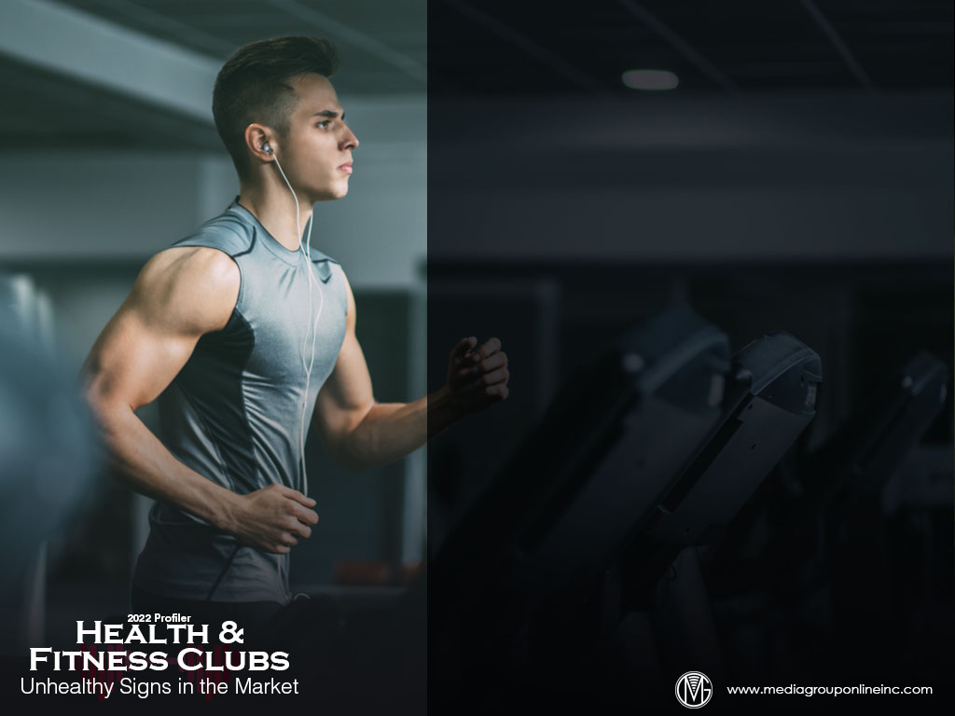
FITNESS CONSUMER INSIGHTS
The June 2021 IHRSA consumer survey found 8% had decreased their use of in-person gyms and 5% had decreased their use of in-person studios. By comparison, 15% had increased use of free online workouts and 13% increased use of home fitness equipment.
Most fitness chains offer major exercise choices, such as cardio and free-weight training. Although memberships have decreased at historical rates, the survey revealed 49% of canceled members planned to return to fitness chains during the next 6–12 months.
Interestingly, men said they were more likely to return to fitness & health clubs than women, or 53% and 47%, respectively. More women (55%) than men (45%) were using home fitness equipment and online workouts, women (63%) and men (37%).

Slide 5
MORE FITNESS CONSUMER INSIGHTS
Data and analysis from five representative 2021 consumer/market surveys conducted by The Media Audit reveal 45 was the average age of adults 18+ who exercised at a health club 12 or more times during the past year and with an average income of $77,800.
Unsurprisingly, adults 25–44 were the largest age group, averaging 30.1%, however, adults 55+ were a close second, averaging 28.3%. The average for adults 45–54 was 19.2% and, somewhat surprising, those 18–24 had the smallest average percentage at 12.1%.
The Provoke Insights survey on page 3 of the Profiler indicates those who are exercising are more optimistic. The Media Audit surveys found financial optimists were 50% more likely, on average, to have exercised at a health club 12 or more times than the market average.

Slide 6
HYBRID WORK BOOSTS EMPLOYEES’ FITNESS
The Provoke Insights survey (June and September 2021) cited on slide #5 found 41% of respondents who were hybrid workers (at office and home) were exercising more. Millennials (27%) and $100K+ household income (28%) were also exercising more.
Those who were exercising less included women (31%), rural populations (30%), unvaccinated people (29%), less than $50K household income (29%), Gen Xers (29%) and Baby Boomers (29%).
Similarly, those who were hybrid workers (36%) and Millennials (23%) said they were fitter than before the pandemic while women (33%), those with a household income less than $50K (30%) and rural populations (29%) said they were less fit than before the pandemic.

Slide 7
TECHNOLOGY: THE FITNESS PARTNER
Health & fitness club members were already using various technologies to augment their exercise programs, but as many preferred at-home fitness programs during the pandemic, smart home exercise brands, such as Peloton, Mirror and Tonal, became very popular.
The June 2021 IHRSA consumer survey cited on slides #3 and #4 also found almost 60% of women (59%) were using “premium digital fitness content,” compared to 41% of men.
According to App Annie’s State of Mobile 2022 report, Millennials over-indexed the most at 111.3 for use of health & fitness apps, with Gen Zers (96.3) and Gen Xers and Baby Boomers (91.0%) under-indexed.

Slide 8
ADVERTISING STRATEGIES
With approximately 25% of all clubs and studios permanently closed, those still open have an excellent opportunity to attract those members with aggressive advertising. Consider a combination of TV to reach older audiences and direct mail to reach them and Millennials.
As more people feel safer about joining and exercising at a health & fitness club, a “Welcome Back” ad campaign with special first-time membership offers or other incentives is a good first step for a better 2022.
With more companies seeking ways to retain employees and hire new workers, clubs may find it advantageous to promote themselves to local businesses and recommend memberships as a retention/hiring perk.

Slide 9
NEW MEDIA STRATEGIES
Ask people to share their unique, funny or family fitness and physical activities during the pandemic on social media and how those activities helped to alleviate boredom and stress, boost their physical and mental health.
Data in the Profiler suggests men are more likely to return to fitness & health clubs. Clubs may want to create a series of social media posts targeting men specifically with fitness tips, membership offers, announcements of new men’s programs, etc.
Similarly, the Profiler also indicates people who are employed full- or part-time and working from home are audience niche with which clubs can engage through social media and promote a specially priced midday program.

