Slide 1
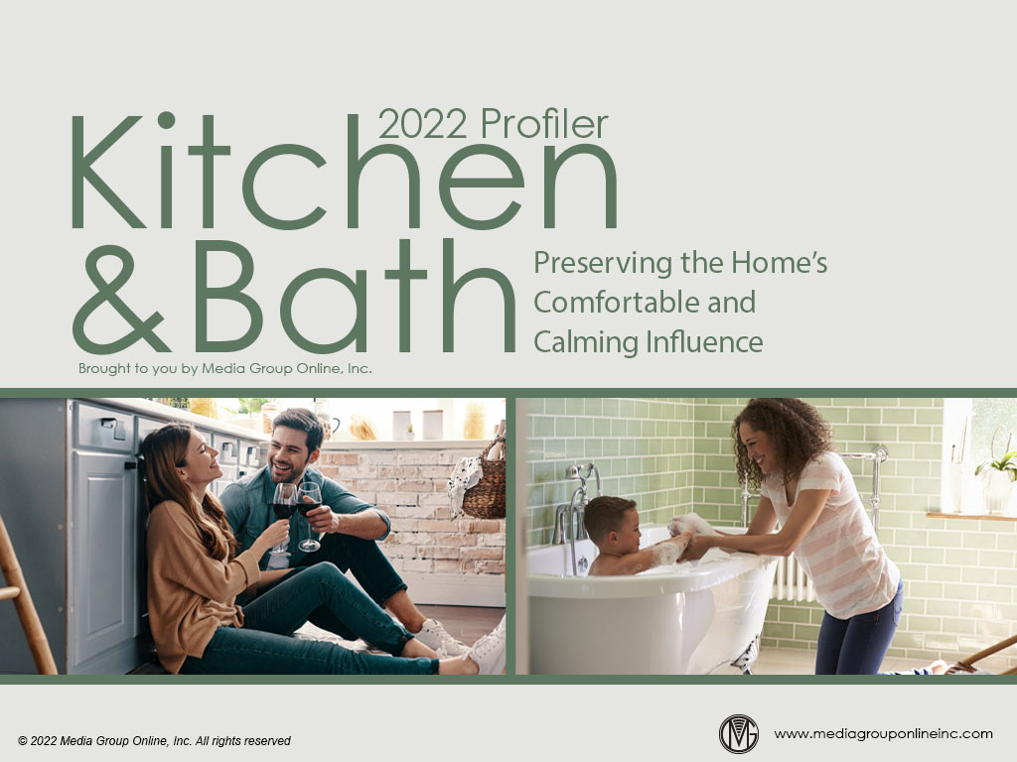

Slide 2
Real Estate and Remodeling Trends
Real estate and remodeling are the primary drivers of the kitchens and baths market. The real estate market continues to face tight inventory and the torrid pace of remodeling spending is forecast to moderate somewhat during 2022.
Despite 16.5% fewer existing homes during January 2022 compared to January 2021, sales increased 6.7% from December 2021. Most of the available homes are priced at more than $500K, which are the homebuyers more likely to afford kitchen and bath renovations.
January 2022 single-family housing starts increased 0.8% YOY; however, housing completions decreased 6.2% YOY and new, single-family home sales decreased 19.3% YOY.

Slide 3
Kitchen/Bath Dealers and Designers’ Business Moderates
The Kitchen & Bath Design News December 2021 survey of dealers and designers found they are facing many of the same challenges as other businesses, including supply-chain issues, inflated product costs and difficulty finding workers.
After an 18.0% increase in 2021 revenues, dealers and designers estimate a 9% increase for 2022, still a very positive trend. More than half (55%) expect their 2022 revenues to increase compared to 2021, but fewer (34%) anticipate a profit margin increase.
Dealers and designers were experiencing substantial increases in sales leads and project requests, with 32% stating “much higher” and 34% stating “somewhat higher.”

Slide 4
Factors Boosting Bathroom Renovations
A recent Zillow homeowner survey found a renovated bathroom would be the first 2022 project a majority of homeowners would consider. Because people find themselves at home more, these consumers said they were willing to pay for spa-like bathroom features.
Approximately 25% of surveyed consumers for the 2021 US Houzz Bathroom Trends Study said the purchase of a new home triggers a bathroom renovation. Another trigger for 54% of homeowners was a family member’s special need, with aging first at 27%.
The Houzz study also discovered an old and outdated bathroom was homeowners’ #1 pet peeve at 69%, which is why so many new homeowners are planning a renovated bathroom during 2022 and to make it functional for the family member with a special need.

Slide 5
Popular Bathroom Styles and Features
The Houzz study revealed 88% of surveyed consumers said they changed the style of a bathroom for renovation. For 2021, the transitional style increased the most from 18% to 21% while the modern style was still the choice of 20% of homeowners.
Because so many homeowners want a spa-like experience in their bathroom, almost a third (32%) add greenery to their bathrooms. “Aesthetically pleasing” at 88% and “calming environment” at 64% were the top two reasons.
White remains the favorite color when renovating a bathroom for four major elements: vanity at 32%, countertops at 58%, shower walls at 46% and non-shower walls at 34%.

Slide 6
Evolving Homelife Focuses on Kitchen
The kitchen trend of becoming more than the place for cooking and eating meals started before the pandemic, but it expanded the kitchen’s use. The 2022 US Houzz Kitchen Trend Study found 52% of renovating homeowners said their kitchen is an entertainment center.
Homeowners were willing to pay the costs of a renovated kitchen during 2021. A major remodel during mid-2021 averaged $40,000, a 14% YOY increase, and the median price of a minor remodel was $10,000, a 25% YOY increase.
The trend of the kitchen becoming a multi-use room is also reflected in the decreasing percentage of surveyed homeowners whose renovated kitchens were open to interiors, from 46% in the 2020 survey to 43% in the 2021 survey to 38% in the 2022 survey.

Slide 7
Popular Kitchen Styles and Features
White continued to be the most popular color for kitchen cabinets among 41% of consumers surveyed for the Houzz Kitchen Trend Study. White was also the first choice for countertops at 39%, a six-percentage-point increase from the 2021 study.
Most surveyed consumers prefer an engineered quartz countertop at 42%. Granite is still second at 24%, but four-percentage points less than the 2021 study. 35% of homeowners chose a butcher block upgraded island countertop to contrast with the other countertops.
When homeowners renovated their kitchen, 50% said they were adding bar stools as the top furnishing/décor, with wall art/décor second at 48%, window coverings third at 39%, a dining table fourth at 29% and plants/greenery fifth at 27%.

Slide 8
Advertising Strategies
With the popularity of AVOD and the increasing implementation of NextGen TV in many markets, kitchen and bath dealers/designers can use these channels effectively to reach Millennials and pair TV with direct mail which is popular with Millennials.
Linear TV is the most-effective ad medium to reach older adults as many more are “aging in place.” Offer a free assessment of any special needs they may require in the kitchen and bath and offer a discount for these renovations.
Dealers and designers may benefit from advertising an upbeat “We’re Living Again” weekend promotion during the early spring, with several featured bundles of kitchen and bath products and in-store seminars from local contractors.

Slide 9
New Media Strategies
Consumers want kitchen and bath renovation ideas, which provides local dealers/designers to partner with a local influencer to share ideas based on local tastes, culture, etc. with short videos posted to social media.
Use social media to conduct one or more polls/surveys and ask visitors to share their most-desired kitchen or bathroom upgrades they are planning for 2022. Promote a drawing from all participants and award a discount to the winner.
Use the table at the bottom of page 3 of the Profiler to create separate, short videos as social media posts to show the latest tech features available for the kitchen and how they can benefit the homeowner as kitchens become even more a center of home activities.

