Slide 2
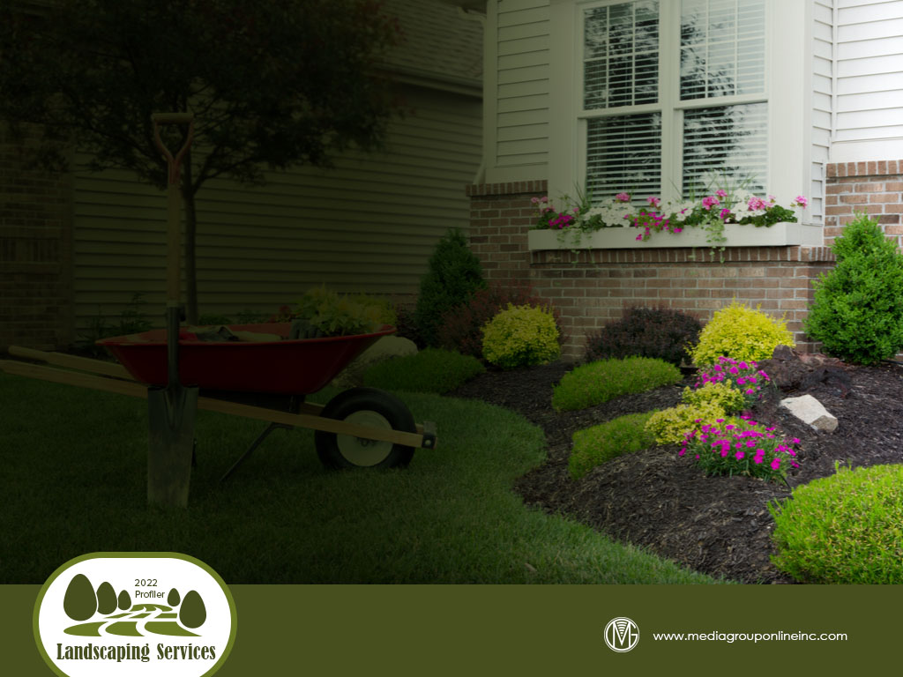
Opportunities and Challenges
Much like many other retail and service verticals, landscaping companies have had an increasing demand for their services, but are stymied by labor issues, limited supplies of plants and other materials and inflationary pressures.
Nonetheless, Landscape Management Network reported in its 2022 State of the Industry survey that industry revenues increased 19% during the 2020–2022 period and were primarily driven by the residential sector.
Since the beginning of the pandemic when more people were staying home and/or working from home, homeowners have wanted to create a safe home environment with a relaxing and welcoming outdoor space.

Slide 3
The Business of Landscaping Services
According to Jobber’s 2021 Home Service Economic Report, contractors it categories as “green” businesses, which includes landscapers, experienced a 14% YOY revenue increase (annualized rate) during Q4 2021.
Landscapers’ customers chose products and services for sustainability, a “green” trend, during 2021: 60% of customers wanted trees or shade trees to alleviate increasing heat and 65% had an interest in native, drought-resistant plants.
Residential customers were also asking for solar-powered outdoor lighting and drip irrigation while local municipalities wanted more rain gardens, trails and bike infrastructure.

Slide 4
Impact of the Real Estate Market
Home sales have always been a driver for landscaping services. Although the current residential real estate market is somewhat volatile, some sources are forecasting a substantial increase in single-family home construction during 2022.
According to Redfin, the very limited number of listings has improved, decreasing just 2% YOY for the week ending 2/20/22, the smallest decrease since mid-November 2021. The median home price continues to increase, limiting the consumers who can afford to buy.
Redfin’s Homebuying Demand Index increased 6% for the week ending 2/20/22, which is a 15% increase from the same 2021 period. Various sources are estimating the market needs one million to four million new single-family homes to satisfy demand.

Slide 5
Profiling the Landscaping Customer
Analyzing data from five representative 2021 consumer/market surveys conducted by The Media Audit finds the average age of adults 18+ planning a landscaping project during the next 12 months was 47 and their average income was $80,500.
Unsurprisingly, when correlating the data by generation, Millennials over-index the most, on average, at 112. Gen Xers very slightly over-indexed at 101, while Boomers, Silent Generation and Gen Zers all under-index, at 97, 93 and 84, respectively.
The data also suggests it may be easier for people working from home to plan a landscaping project. Those who work from home for any number of days over-indexed, on average, at 130, compared to those who are employed full-time and never work from home at 110.

Slide 6
Consumer Spending for Landscaping Projects
Reviewing more data from The Media Audit’s five 2021 representative consumer/market surveys indicates 58.9% of adults 18+ who completed a landscaping project during the past 12 months spent less than $500, suggesting most of these were DIY projects.
Approximately one-third (34.6%) spent $500 to $4,999, which was probably a mix of DIY and landscaping contractor projects. Just 6.4% spent $5,000 or more and are much more likely to have been landscaping contractor projects.
Interestingly, the average age of adults spending $5,000 or more was the youngest at 45; however, those spending $500 to $4,999 had an average age of 50 but had the largest average income at $88,500.

Slide 7
Media Targeting of Landscaping Customers
Adults 18+ in the same five markets who are planning a landscaping project during the next 12 months are more heavily exposed to newspaper (147), direct mail (138) and outdoor (132) than radio (125) and TV (94) by average indices during an average day.
Quite surprisingly, adults 18+ planning a landscaping project over-index the most for having logged onto LinkedIn during the past month at an average of 135, followed by Pinterest at a 127 average and Twitter and TikTok both at a 121 average.
Interestingly, among five digital media, adults 18+ over-index the most for daily heavy exposure to podcast listening, on average, at 162, compared to the Internet (92), social media (101), audio streaming (118) and video streaming (110).

Slide 8
Advertising Strategies
Although landscaping customers under-index slightly for heavy exposure to TV, landscaping services can benefit from a combination of TV to broad reach of its message and direct mail, which is popular with Millennials who are the primary target audience.
As the pandemic wanes and more homeowners are comfortable with contractors in their homes, landscaping companies may find it beneficial to offer a free landscaping assessment and a discount when any of those leads purchases a qualifying package of services.
Landscaping companies can tap into the real estate market by targeting potential home sellers with a promotion to update their property’s landscaping to help attract highly qualified buyers and a maximum selling price.

Slide 9
New Media Strategies
Because so many homeowners, especially younger adults, often decide where to spend their money based on a company’s commitment to sustainability, landscaping companies can use social media to post content, short videos preferably, to explain their commitment.
Since most landscaping projects are DIY projects, landscaping companies can use social to share quick tips in short videos and to promote a free landscaping assessment to generate leads from homeowners who decide they don’t have the skills for a DIY landscaping project.
More consumers expect transparency from the business where they spend their money. Landscape companies can share the current status of plant shortages from nurseries and other challenges on social media to help customers understand any project delays.

