Slide 1
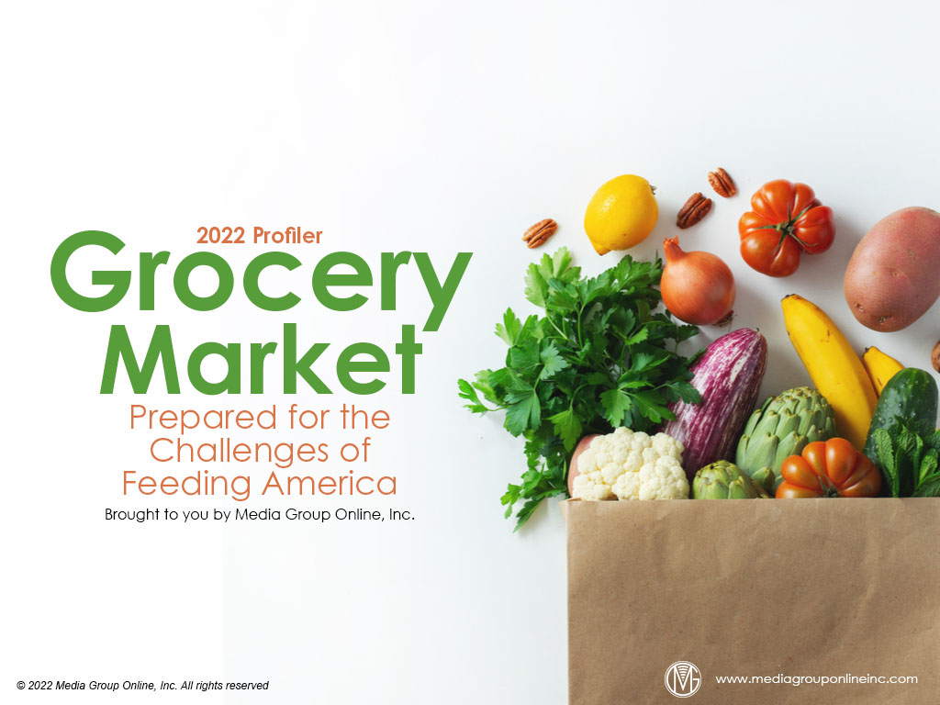

Slide 2
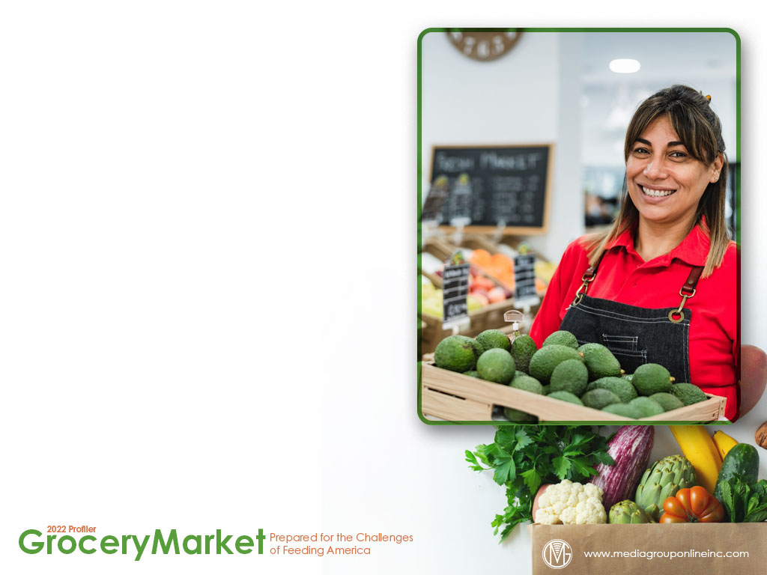
Market Gains Despite Challenges
As with virtually all retail verticals, the grocery market faces the same challenges, from supply-chain issues to labor and hiring to consumer inflation. Nonetheless, grocery stores (NAICS 4451) recorded an 8.3% YOY sales increase during Q1 2022, or $199.05 billion.
The latest monthly report from the US Census Bureau indicates grocery stores’ sales increased 10.1% YOY during April 2021 to $68.41 billion, although much of the increase is likely attributed to increasing food and beverage prices.
The 2022 Axios-Harris Poll of reputation rankings shows consumers continue to have high regard for the grocery category, as Trader Joe’s became #1 for the first time, H-E-B was second and Wegmans was third.

Slide 3
Foot-Traffic Trends
According to Placer.ai data, visits to the grocery sector were trending down during Q1 2022 when January visits increased 9.1% YOY, but only increased 0.7% compared to January 2019. During March, the numbers were +0.4% and -3.3%, respectively.
Foot traffic improved somewhat during April and May 2022, with a 2.6% YOY and a 0.7% 3YOY increase during April and a 0.6% YOY and a 2.7% 3YOY increase during May.
Throughout May, however, visits to superstores were substantially more than grocery stores. Grocery store visits peaked during the week of 5/9 at +1.8% YOY, but superstore visits also peaked during the same week at +8.0% YOY.

Slide 4
The 800-lb. Inflation Gorilla in the Room
In its June 2022 Global Consumer Insights Pulse Survey, PwC found 73% of surveyed US consumers said increasing grocery prices were having the greatest impact when shopping in a physical store and 60% said when shopping online.
First Insight’s June 2022 The State of Consumer Spending report compared in-office and remote/hybrid workers and more than 80% of both said they were using less expensive methods to shop because of inflation, or 80% and 86%, respectively.
Unsurprisingly, these workers said gasoline and groceries prices were increasing most and having the most impact on their lives. Groceries were the top spending priority for in-office workers at 53% and remote/hybrid workers at 61%.

Slide 5
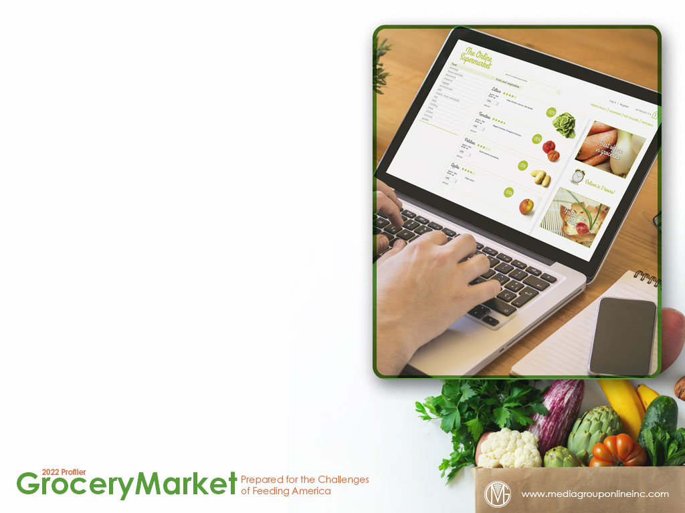
Grocery E-commerce Struggles Forward
Grocery e-commerce shopping has certainly cooled from its historical acceleration during mid-2020. The latest Brick Meets Click/Mercatus Grocery Shopping Survey of late May 2022 found May online grocery spending decreased 12.3% from April, another victim of inflation.
May’s total of $7.1 billion did increase 1.7% YOY. Pickup and delivery sales were primarily responsible for making May better than it might have been. Pickup sales increased 9% YOY and delivery sales increased 5% YOY.
Despite the current challenges for grocery e-commerce, grocery executives are very bullish on future sales. In a February 2022 McKinsey & Company survey, they achieved an average of 11% penetration of online spending, but expect to achieve a 23% penetration by 2027.

Slide 6
Identifying the Grocer Shopper
According to the survey results for the Food Industry Association’s (FMI) US Grocery Shopper Trends 2022 report, 81% of respondents said they shop at supermarkets, 65% at mass-market retailers, 44% at wholesale clubs and 30% at online-only retailers.
Inflation and supply-chain issues prompted 85% of surveyed consumers to state they were concerned about access to food, 53% found prices are increasing for their food preferences and 45% are shopping for groceries that are not available.
The McKinsey & Company November–December 2021 survey cited on slide #5 found most consumers (41%) were still stocking the pantry with their monthly grocery spending as they did during mid-2020 while 24% were shopping for a few items with those monthly dollars.

Slide 7
Young Adults’ Grocery Shopping Perspectives
In its July 2021 consumer survey, Progressive Grocer polled Gen Zers and Millennials about their grocery shopping habits, and “the food tastes good” was first at 69% and 70%, respectively, as the top factor for deciding what food to purchase.
Somewhat surprisingly, younger adults were much more likely to make a meal or find something to eat at home than order pickup, takeout or delivery: Gen Zers 70% and 37% and Millennials 77% and 39%, respectively.
“A great way to discover new and interesting products” was the top reason Gen Zers and Millennials at 54% each liked shopping in a grocery store. “An enjoyable experience” was second at 44% and 42%, respectively.

Slide 8
Grocers Are Optimistic About Fresh Food Sales
According to a survey of 50 grocery retailers/wholesalers for the Supermarket News 2022 Fresh Food Trends Report, 70% said sales in their perimeter categories, which include most fresh foods, increased during the past 12 months (from March/April 2021).
Most of those surveyed agreed consumers continuing to eat more at home as they have since the start of the pandemic was the biggest factor increasing perimeter sales.
During the next 12 months (through March 2023), 66% of these retailers/wholesalers expected their perimeter categories’ sales to increase and just 9% to decrease. A vast majority (80%) expected an increase of 1% to 9%.

Slide 9
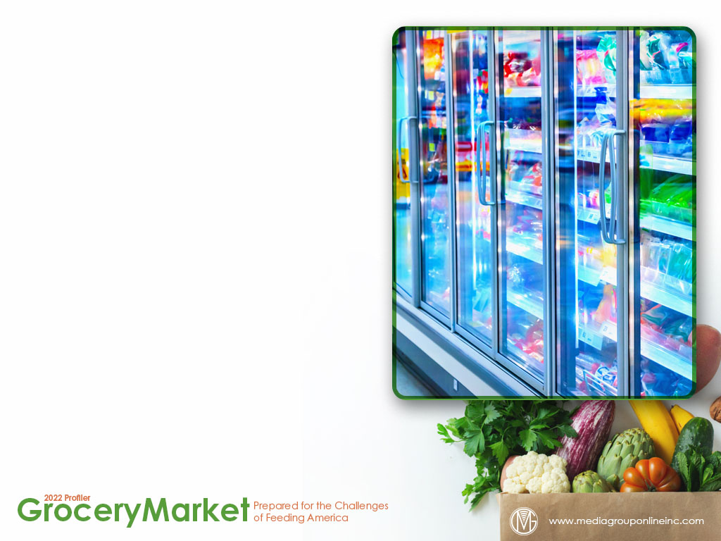
Specialty Food Sector to Continue Growth
The Specialty Food Association (SFA) reports sector sales increased 7.4% during 2021 to a total of $175 billion. The brick-and-mortar retail channel accounted for $144.2 billion, food service for $28.8 billion and the online retail channel for $2.0 billion.
The multi-outlet channel (MULO), which includes grocery, mass-market, drug, Walmart, dollar, military and club subsectors, accounted for $75.0 billion in 2021 specialty food and beverage sales while natural & specialty stores accounted for $12.2 billion.
Of the top 10 categories in specialty food & beverages, SFA reports sales of refrigerated/frozen items (meat, poultry and seafood) increased the most from 2020 to 2021 at 32% and chocolate and other confectionery second at +17%.

Slide 10
Plant-Based Foods Gain in Popularity
Datassential surveyed 1,500 Americans during April 2022 about their plant-based eating habits and found 71% of them said they are meat eaters; however, the other 29% were limiting their consumption of meat, predominately “flexitarians” at 22%.
Although 2% fewer respondents (20%) said they were eating nuts and legumes daily as plant-based protein sources than in the 2021 survey, 6% more (49%) were eating them once or more per week.
Half of the survey respondents agreed plant-based foods are better for the environment, with students at 67%, the highest percent, followed closely by those who are climate concerned at 66%. Less than half (46%) of daily meat eaters agreed.

Slide 11
Food Co-ops Support Their Communities
In its 2021 Food Co-op Impact Report, National Co+op Grocers (NGC) states it represents 148 community-owned food co-ops, operating in 38 states and with 1.3 members.
Shoppers save an average of 25% on 2,400 and more items weekly when using Co+op Deals while 379 high-quality items are offered at everyday low prices through NGC’s Co+op Basics program.
Among all items purchased at NGC co-op members, 40% are certified organic products. NGC and its co-op members are dedicated to lessening their environmental impact. The report indicates electricity use decreased 11% from 2020 to 2021.

Slide 12
The Future of the Grocery Market Depends on Technology
According to the 2022 Connected Retail Experience Study from Incisiv, retailers and grocery stores, specifically, will be compelled to deploy 5G technology as more consumers’ mobile devices have 5G and the use of Internet of Things (IoT) technology increases.
The grocery and general merchandise stores surveyed for the study expect automated store associate tasks will triple from 19% during 2021 to 62% by 2025, compared to an approximately doubling at specialty and department stores from 37% to 72%, respectively.
In the RIS Grocery Tech Trends 2022 report, 74% of grocers said they will have to increase their investment in retail technology to offset their limited access to labor and 12% expect to start to upgrade to autonomous inventory robots during the next 12 to 24 months.

Slide 13
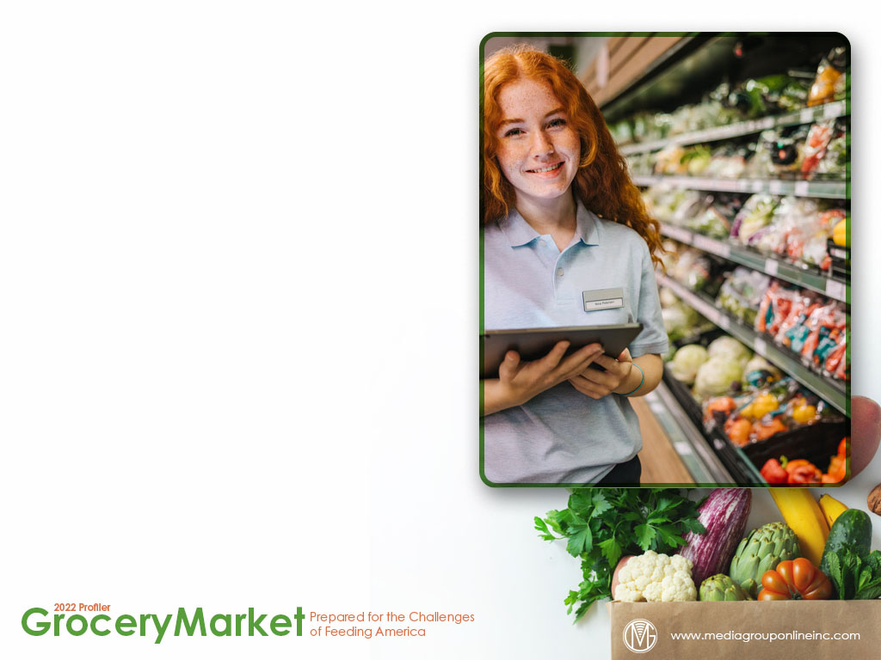
The New Supermarket
Progressive Grocer’s 89th Annual Report presents a list of strategies for grocery stores to remain competitive. Among these are adding technologies to make the customer’s experience more appealing and demonstrating their sustainability efforts.
New software allows smaller independent grocers to offer delivery service that competes with the largest chains. Grocery stores that continue to promote locally sourced products and react quickly to consumers’ changing tastes are more likely to increase market share.
Private brands remain popular with consumers. FMI’s Power of Private Brands report found the cost savings of private brands is still a primary driver with 55% of consumers, but more of them are attracted to private brands’ quality, taste, sustainability and health value.

Slide 14
Advertising Strategies
To maintain or even increase grocery store visits, grocers can initiate and advertise a free gasoline card promotion with a qualifying purchase. Another promotion is to offer a limited-time discount for delivery service so customers don’t have to use gas to visit the store.
Young adults like grocery shopping “to discover new and interesting products.” Grocery stores can use a reach medium, such as radio or TV, to brand themselves as the discovery portal to new products and cross-promote on social media.
Special offers on private brands are likely to attract more consumer dollars. Ad messages should promote private brands’ quality, taste, sustainability and health value as much as their cost savings as more consumers are recognizing these added benefits.

Slide 15
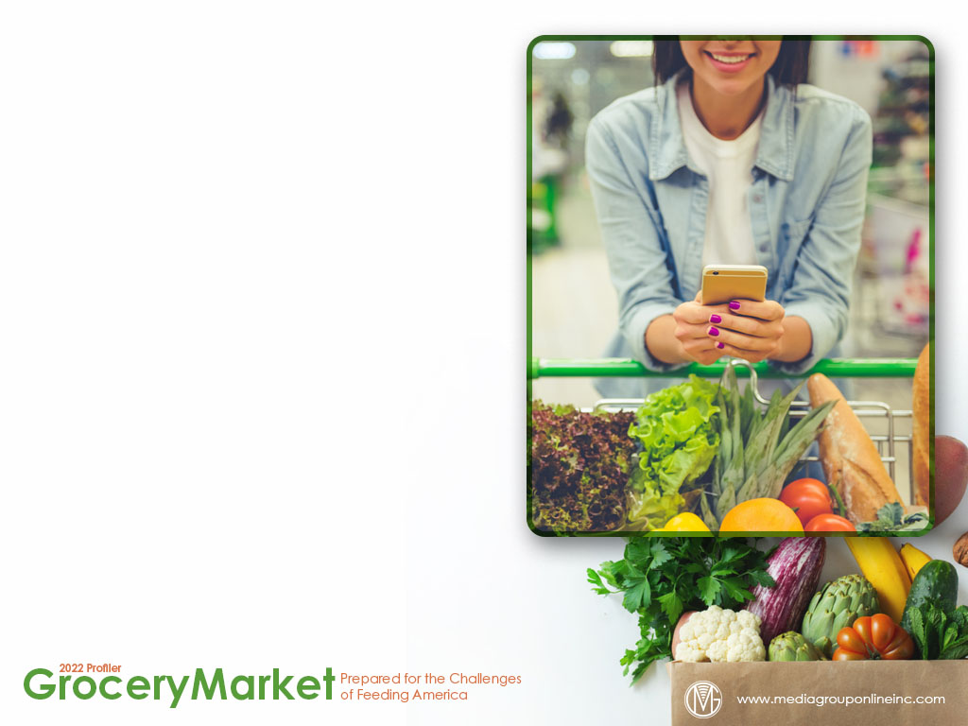
New Media Strategies
Because technologies enhance and improve the shopping experience for consumers, grocery stores can use social media to share their challenges of new technologies, when they plan and then introduce new technologies and even offer to help consumers adjust to them.
Grocery stores can use social media and consider sponsored content opportunities to share information with consumers to help save money, suggest substitute products, tips from a chef or nutritionist about how to extend the use of meat and other hints.
With more younger adults making a meal at home, grocery stores may want to find a young, local food influencer to share recipes, how to outfit your first kitchen and other information to convert more young adults to home cooking, and buying more groceries.

