Slide 2
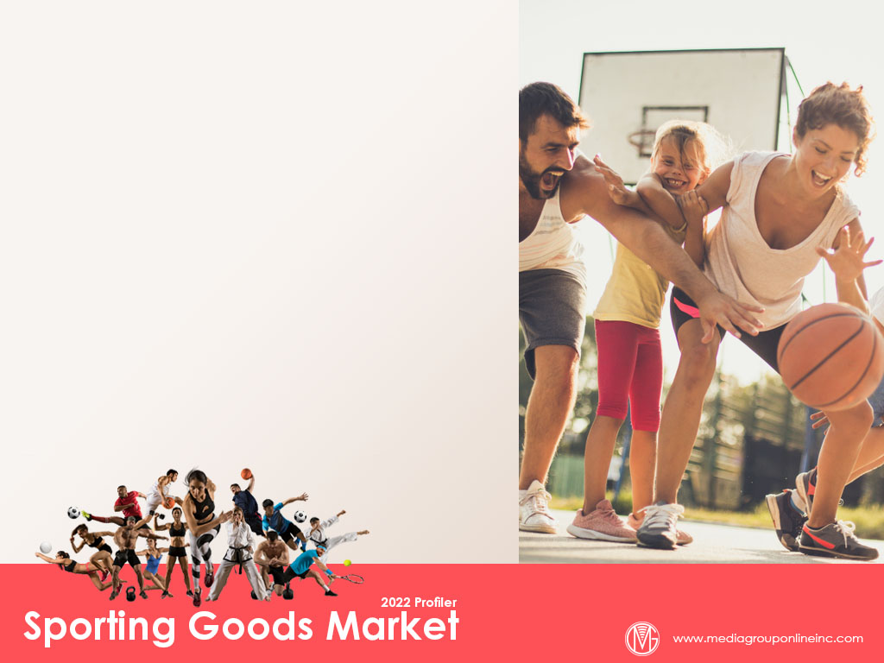
Sales Moderate After Strong Years
The pandemic drove many people outdoors to escape and increase their physical activity. Unsurprisingly, therefore, total 2021 sales at sporting goods stores increased 24.2% from 2020; however, 2022 sales to date (through April) have decreased 2.2%.
The NPD Group reports specific sporting goods categories fared better during Q1 2022, with sales for baseball, lacrosse, soccer and racquet sports equipment increasing 19% YOY, although the impact of inflation was much less during Q1 than Q2 2022.
The NPD Group also cited the increased emphasis on health and wellness propelled activewear sales to a 39% increase during January–April, compared to the same 2019 period. January–April outdoor equipment sales increased 25%, compared to 2019.

Slide 3
Competing Against Inflation and Inventory Issues
The rapid increase in inflation during Q2 2022 forced most consumers to spend more for essential products and services, such as groceries and gasoline, and less for discretionary products, such as exercise and sports equipment.
The Morning Consult July 2022 Supply Chains & Inflation survey found consumers were more price sensitive for exercise and sports equipment. They were more likely to trade down or make no purchases except for apparel and personal care goods or services.
The Morning Consult June 2022 US Household Finances & Spending Report stated 52% of adults said they had money after paying their monthly expenses during May 2022, compared to 58% during February 2022 and almost 62% during June 2021.

Slide 4
The Outdoors Consumer
Provoke Insights’ March 2022 outdoors consumer survey found 9% of Americans had purchased outdoor gear during the past month. Almost two-thirds (63%) made those purchases at a store, 27% from an e-commerce site and 9% from a brand’s Website.
The profile of the outdoors gear shopper is men (57% vs. 45% of all consumers), have children (49% vs. 35% of all consumers), employed full-time (75% vs. 63% of all consumers) and environmentally conscious (70% vs. 56% of all consumers).
Almost two-thirds (63%) of surveyed consumers who purchased outdoor gear said they preferred to purchase it from small businesses, 56% were willing to pay more for sustainably-sourced items and 27% looked for the cheapest brand available.

Slide 5
Outdoor Activities Trends
The Provoke Insights survey also revealed 51% of consumers said they exercise during their free time, 31% participate in camping and hiking, 23% go biking and 13% play golf.
Research from Placer.ai indicated foot traffic at national and state parks, which are primary destinations for camping and hiking, decreased 9.7% YOY during April 2022 and 35.7% YOY during May 2022, compared to YOY increases during Q3 and Q4 2021.
The high gas prices had a significant negative impact on foot traffic at national and state parks during the 2022 Memorial Day Weekend: 5/27 at -55.3% YOY, 5/28 at -40.9% YOY, 5/29 at -35.5% YOY and 5/30 at -36.2% YOY.

Slide 6
Golf Industry Update
Media Group Online’s Golf Industry 2022 Profiler explained rounds played across the US through March 2022 had decreased from 2021. This trend continued with rounds played during April decreasing -6.8 YOY, however, May’s rounds increased 2.7%.
It’s likely weather, inflation and the pandemic caused these declines, but April 2021’s rounds increased 81.5% and May 2021’s rounds 18.1%. The April/May 2022 decreases must be measured against 2021 and a 16% increase in total golfers from 2016 to 2021.
Although the golf industry doesn’t want courses to close, the National Golf Foundation is projecting 95 18-hole courses will close during 2022, but approximately 275 closed during 2019 and 130 during 2021.

Slide 7
Major Chains News
Dick’s Sporting Goods reported a 7.5% decrease in Q1 sales, but this must be measured against a 119% sales increase during Q1 2021. Plus, Q1 2022 net sales increased more than 40%, compared to Q1 2019.
Despite Dick’s Sporting Goods’ softer financials, research from Placer.ai shows visits increased 6.4% at the flagship stores, 10.8% at its Field & Stream stores and 9.2% at its Golf Galaxy stores during April 2022, compared to April 2019.
Academy Sports + Outdoors is targeting 80 to 100 new stores during the next five years, a significant increase from its 260 stores in 16 states. It recently added its first two locations in the Tampa Bay area and will open its first Virginia and West Virginia stores during 2022.

Slide 8
Advertising Strategies
Launch a “Don’t Stop Now” ad campaign, targeting new customers who started new exercise or sports activities as relief from the pandemic. Offer a discount or coupon for a qualifying purchase of the “next level” of equipment from what they initially purchased.
Use a media mix of TV and direct mail (and social media) to engage with Baby Boomers who are focused on their health and wellness and longevity. Share information about certain kinds of exercise and sports enhance these goals and offer a discount or coupon.
Launch a “Be a Sport” campaign. Ask customers for donations during a weekend promotion, which the store matches, to provide sports equipment for low-income neighborhoods’ youth sports programs. Use an online fundraising site and invite other businesses to participate.

Slide 9
New Media Strategies
Ask customers to post photos and videos on social media, sharing their experiences trying a new exercise program or sports activities during the past two years. Offer a QR code to everyone who posts for a weekend-only discount.
Use the Provoke Insights’ profile of the outdoors gear shopper on page 2 of the Profiler to create a series of social media posts, with each featuring an outdoors gear product that are likely to attract shopper profile.
Similarly, the content in the table at the bottom of page 2 of the Profiler can be used to create individual social media posts, targeting adults 25–64 with limited-time special offers for equipment for each activity.

